Slide 1
Metallogenesis in New South Wales: new (and old) insights from spatial and temporal variations in radiogenic isotopes
David L Huston, David C Champion, Terrence P Mernagh (Geoscience Australia)
Peter Downes (Geological Survey of New South Wales)
Phil Jones (Straits Resources)
Graham Carr (CSIRO Earth Sciences and Resource Engineering)
David Forster (Geological Survey of New South Wales)

Slide 2
Why radiogenic isotopes?
Provides information about sources
Nd in granites – lower crust and upper mantle
Pb in ores – largely upper crust
Provides information about crustal boundaries
Many deposits associated with crustal boundaries (IOCG, lode gold, porphyry Cu)
Provides information about crustal character
Archean VHMS deposits – juvenile crust
Archean KANS deposits – evolved crust
Lachlan porphyry Cu-Au deposits – juvenile crust

Slide 3
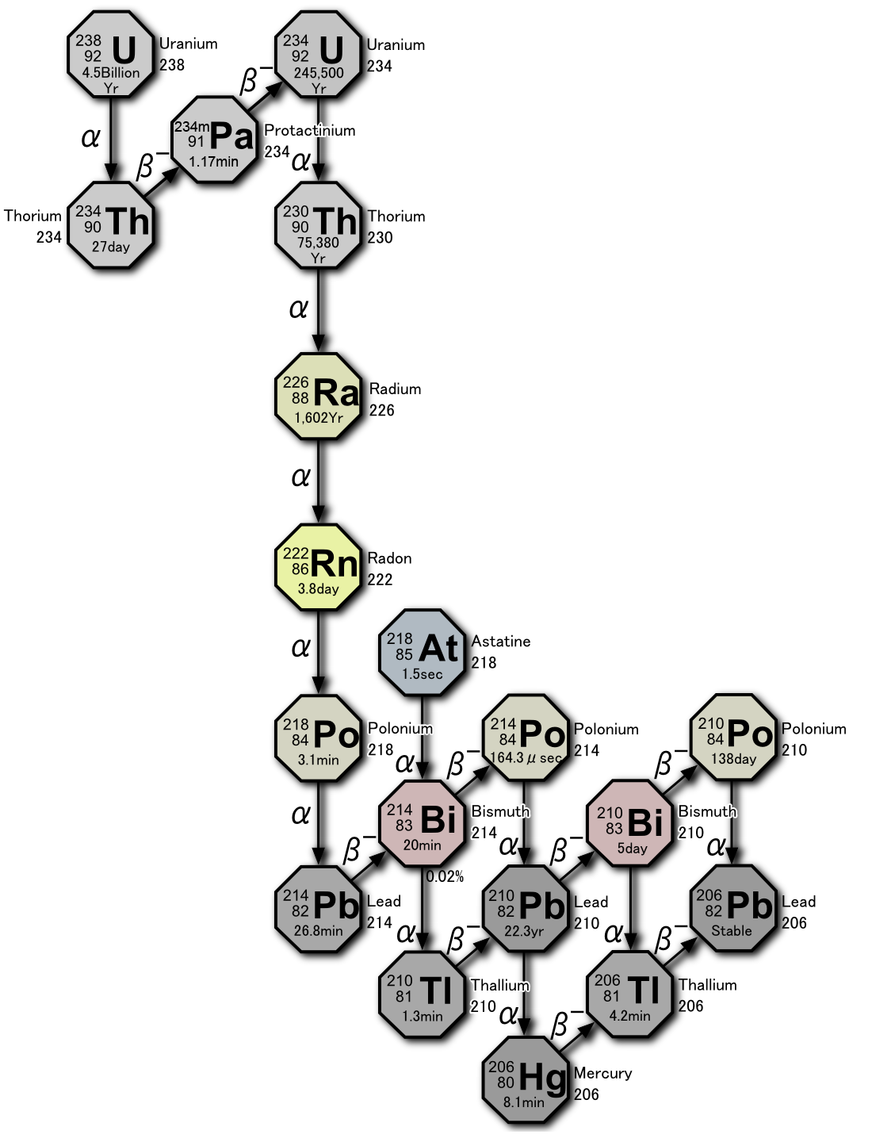
Basics of lead isotopes – nuclear reactions
²³⁸U → ²⁰⁶Pb
Total Pb =
radiogenic Pb +
non-radiogenic Pb
(time dependent)
²³⁵U → ²⁰⁷Pb
²³²Th → ²⁰⁸Pb
²⁰⁴Pb: non-radiogenic
Lead isotope data normalised to ²⁰⁴Pb:
²⁰⁶Pb/²⁰⁴Pb; ²⁰⁷Pb/²⁰⁴Pb;
and ²⁰⁸Pb/²⁰⁴Pb
wikipedia.org

Slide 4
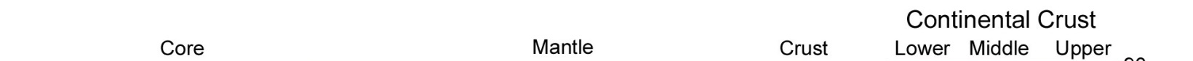
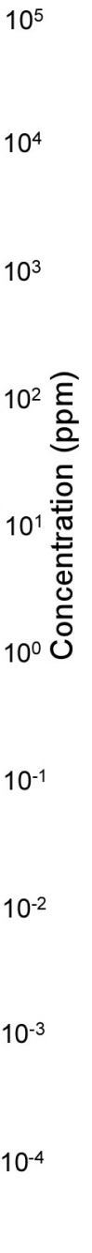

Basics of lead isotopes – uranium-lead fractionation
Pb
U

Slide 5
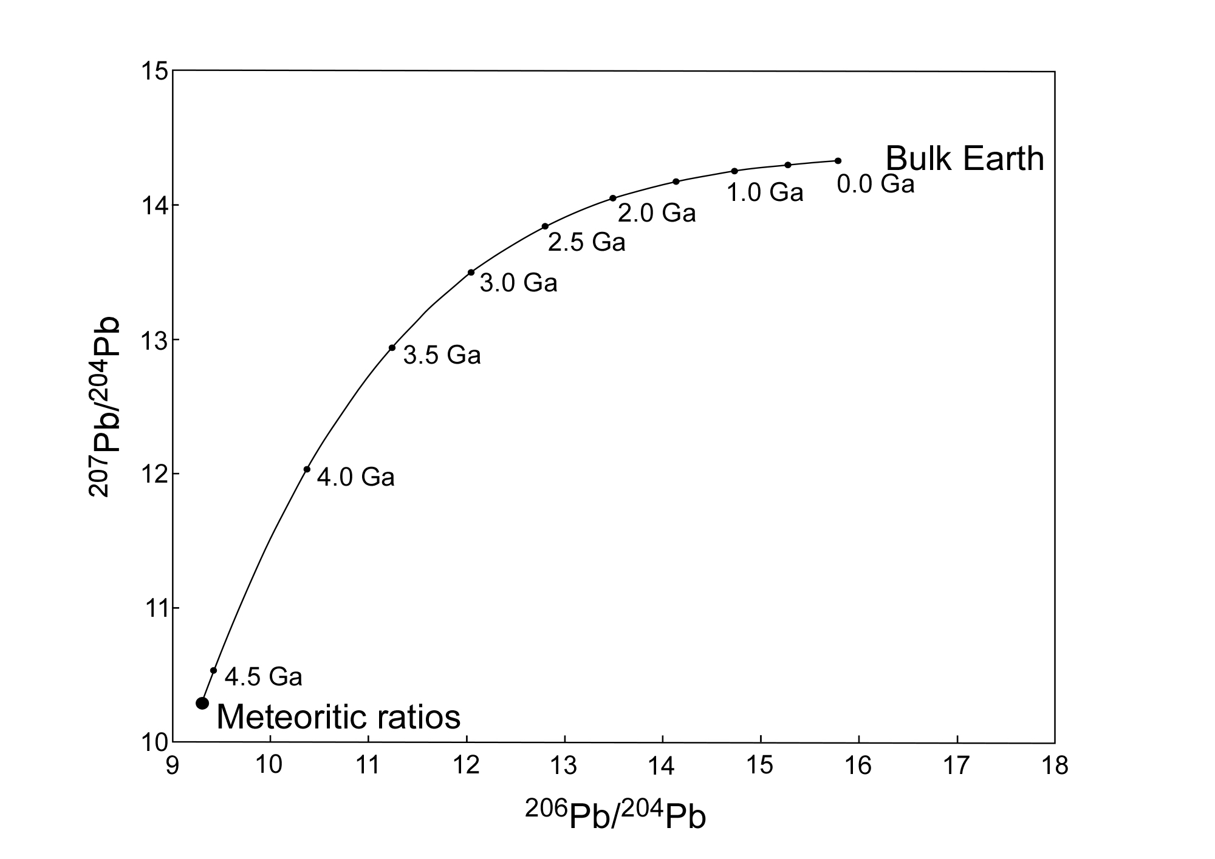
Basics of lead isotopes – growth models
Evolution of bulk earth

Slide 6
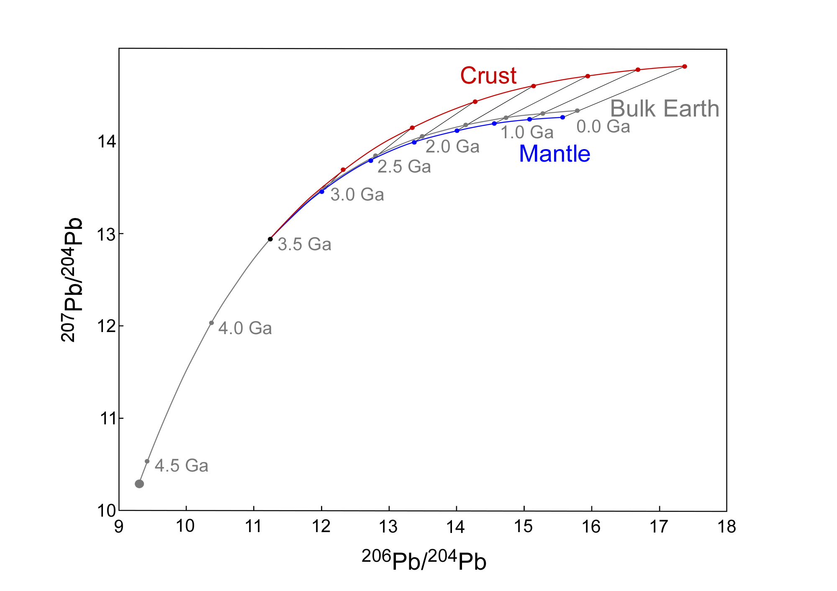
Basics of lead isotopes – growth models
Hypothetical crust
formation at 3500 Ma
Processes that cause U-Pb fractionation
Initial chemical differentiation
Formation of new crust
Melting – magma formation
Surficial processes – particularly after atmosphere inversion
Result: large range of Pb isotope growth paths and growth curves are provincial

Slide 7
Basics of lead isotopes – what do they provide?
Lead isotope evolution models
Global models – variable sophistication (generally don’t work in detail)
Local models – empirical (can work very well) Abitibi-Wawa (Thorpe, 1999); Lachlan (Carr et al, 1995)
Lead isotope evolution models provide:
Model ages – accuracy dependent on model; assumes initial ratios
Source character (juvenile vs evolved) –
μ (²³⁸U/²⁰⁴Pb) and other parameters
Empirical exploration guides

Slide 8
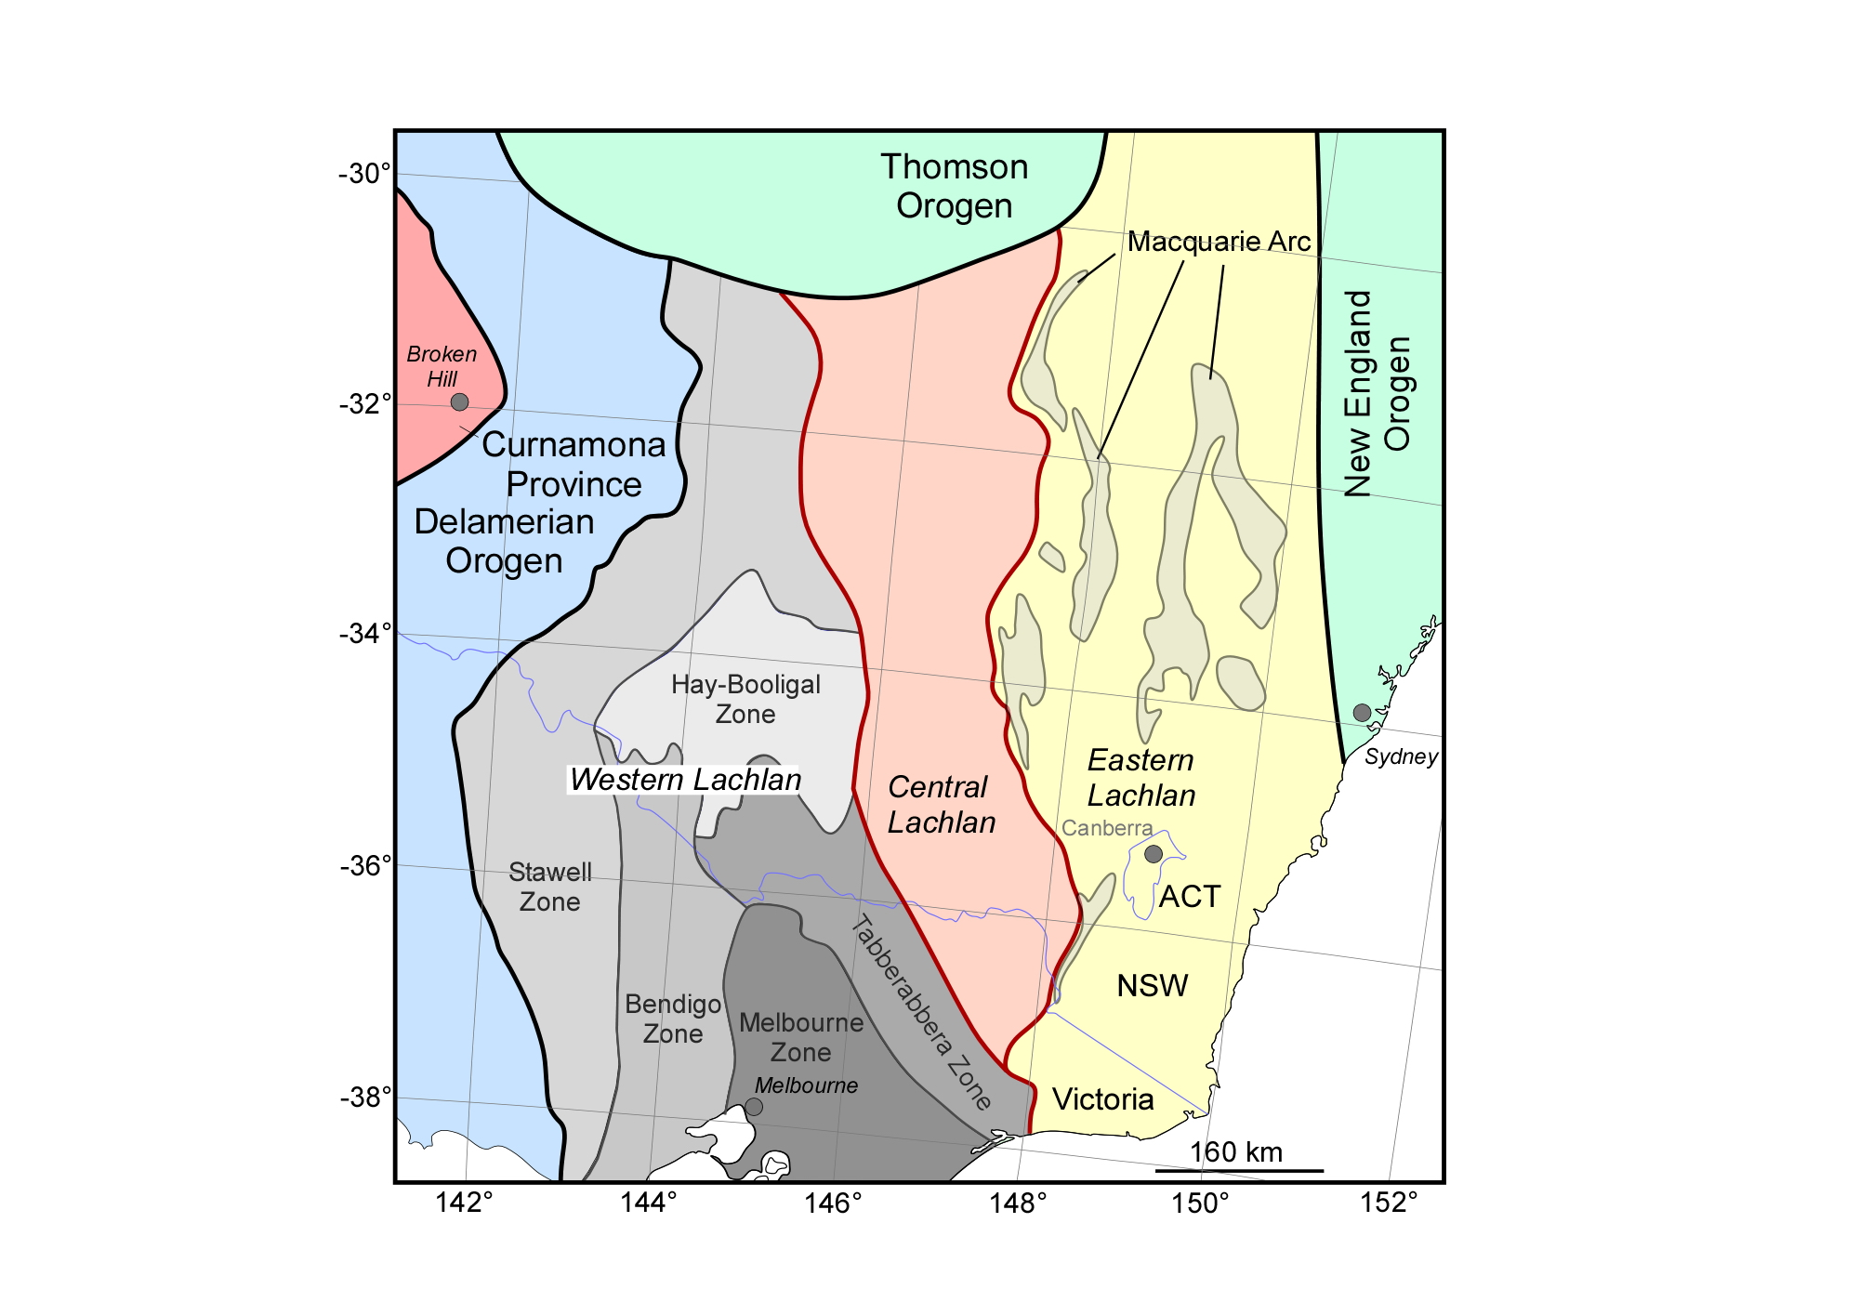
Provinces of the Lachlan Orogen

Slide 9
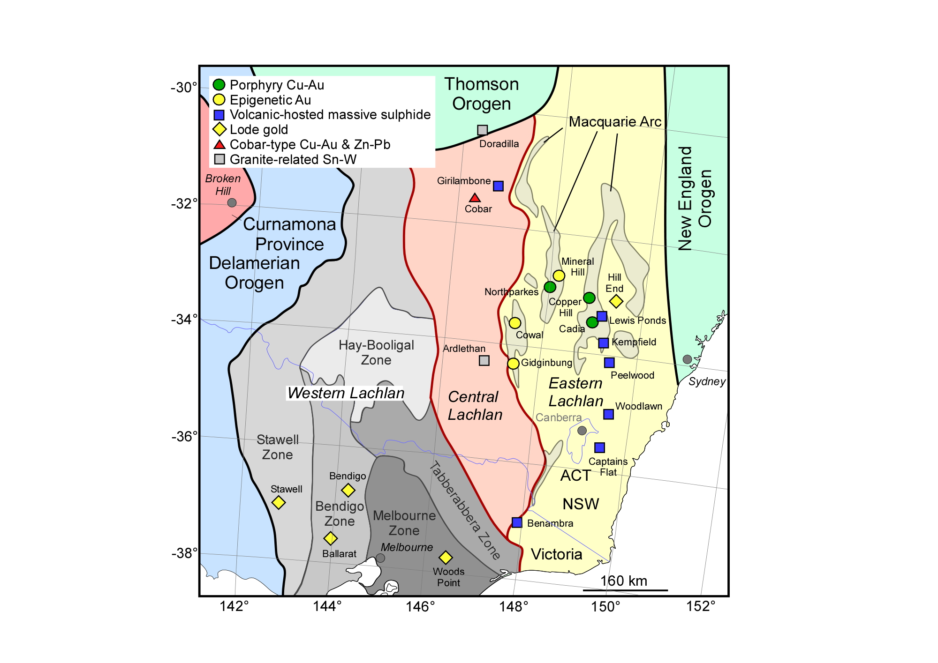
Major mineral deposits of the Lachlan Orogen
Wagga Sn-Mo
(410-230 Ma)
Ordovician
VHMS
(~480 Ma)
Macquarie
porphyry-epithermal
(450-420 Ma)
Silurian
VHMS
(~420 Ma)
Victorian lode gold
(~440 Ma; ~380 Ma)

Slide 10
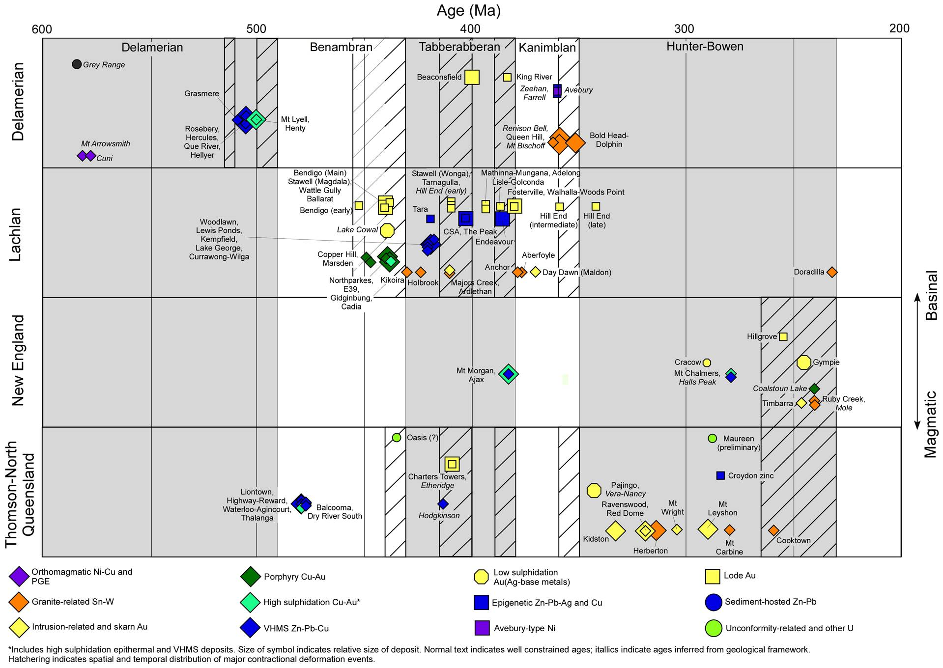
Timing of mineralisation in the Tasmanides
Kanimblan
Lode gold
Delamerian
Hunter-Bowen
Porphyry-epithermal
VHMS
Bindian
Tabberabberan
Benambran
Lode gold
Kanimblan

Slide 11
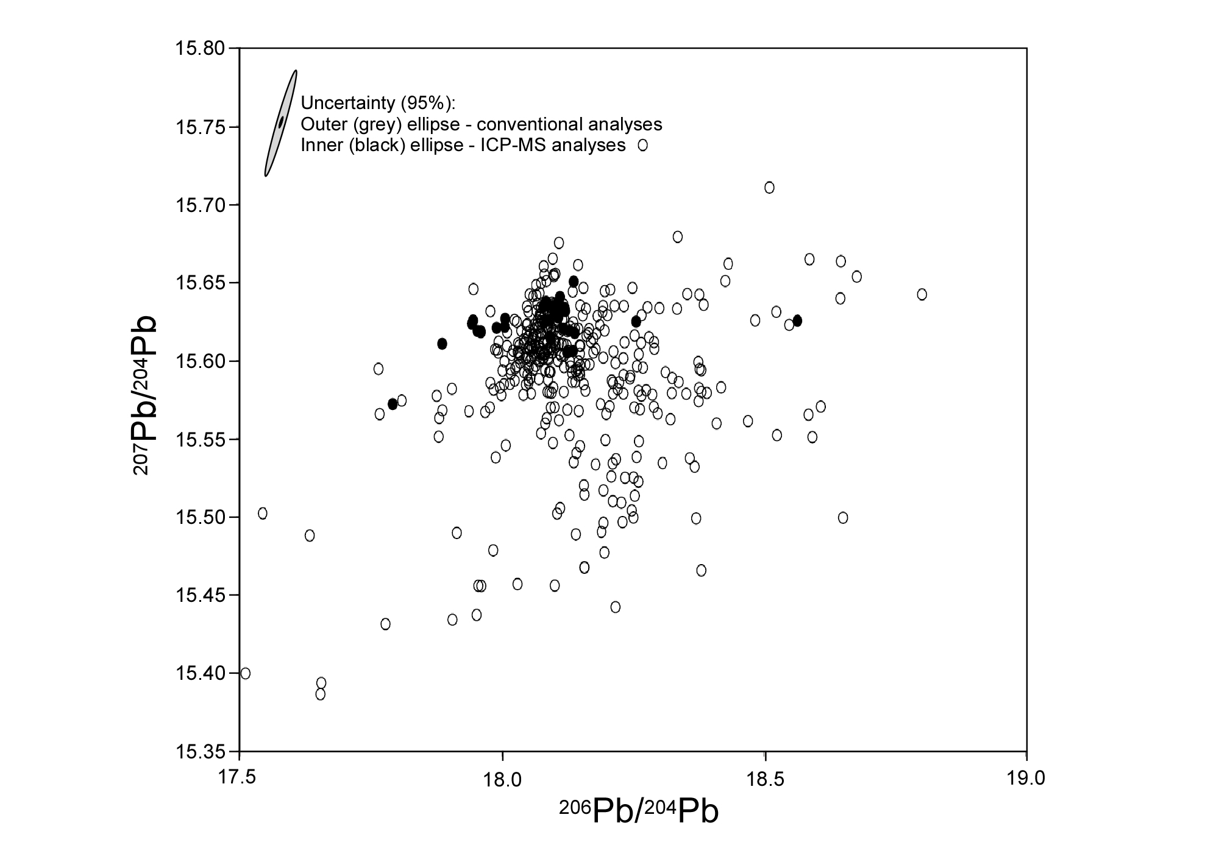
Lead isotopes in Lachlan – ²⁰⁶Pb/²⁰⁴Pb vs ²⁰⁷Pb/²⁰⁴Pb
Data sources:
CSIRO (open); new
ICP-MS (closed) analyses
Variations
in source
Variations
in time
> 400 deposits/occurrences
Least radiogenic analyses

Slide 12
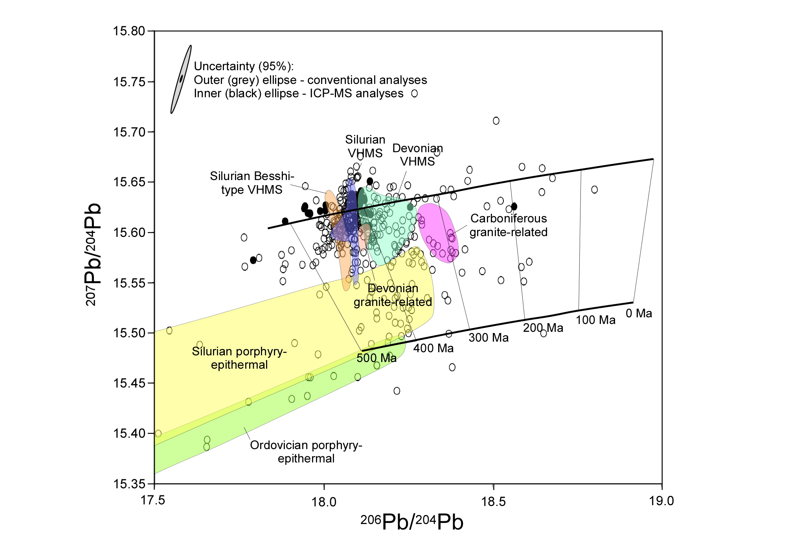
Lead isotopes in Lachlan – Growth curves
Crust
Mantle
Fields and evolution curves from Carr et al. (1995)

Slide 13
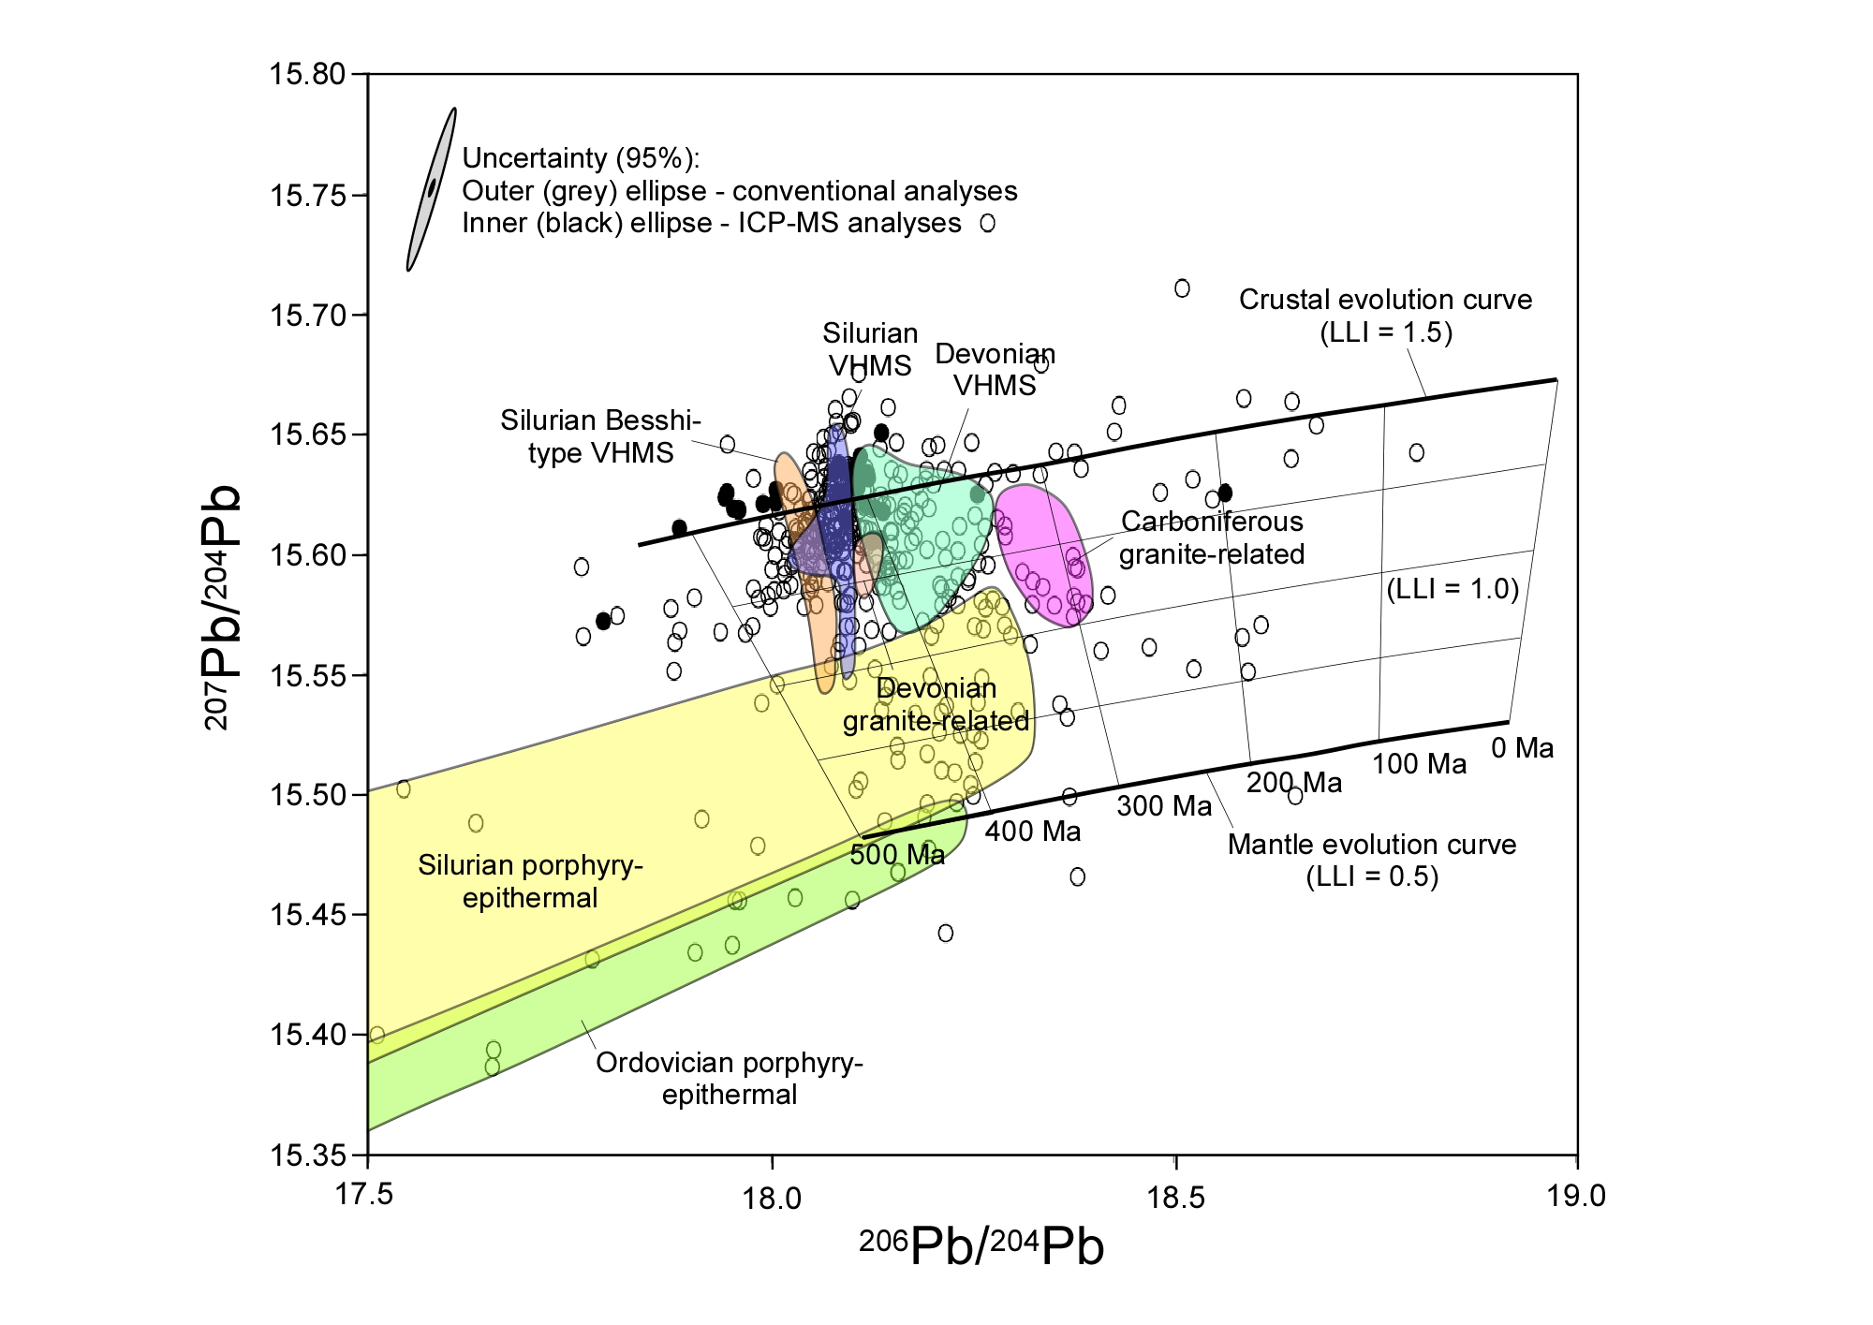
Lead isotopes in Lachlan – Lachlan Lead Index
Captains Flat:
Model age ~ 440 Ma
LLI ~ 1.3

Slide 14
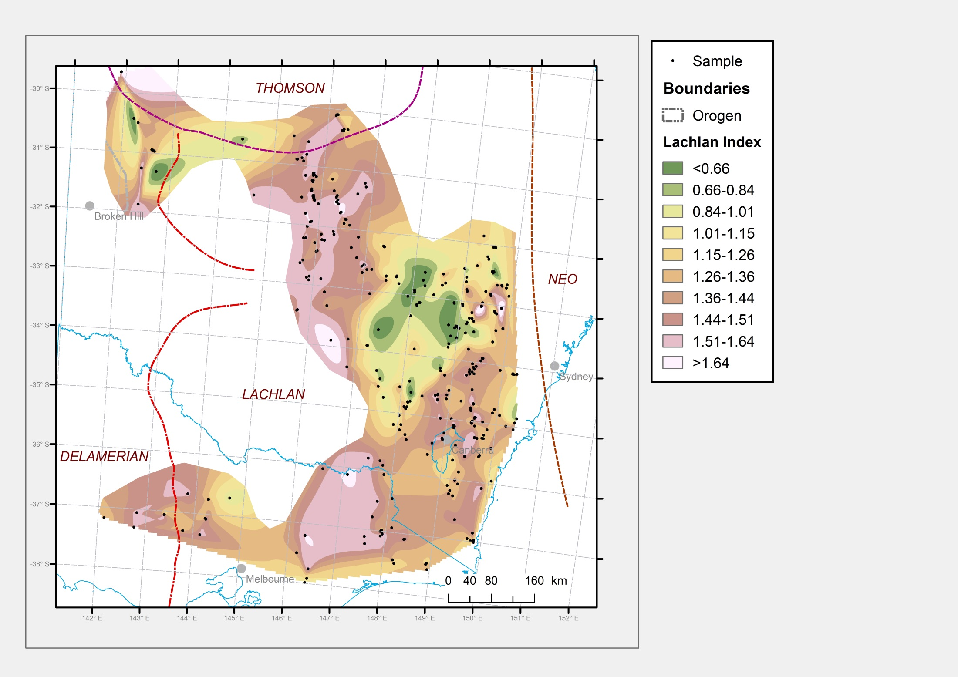
Lead isotopes in Lachlan – Spatial variations in LLI
Juvenile
Approximate
uncertainty
Evolved

Slide 15
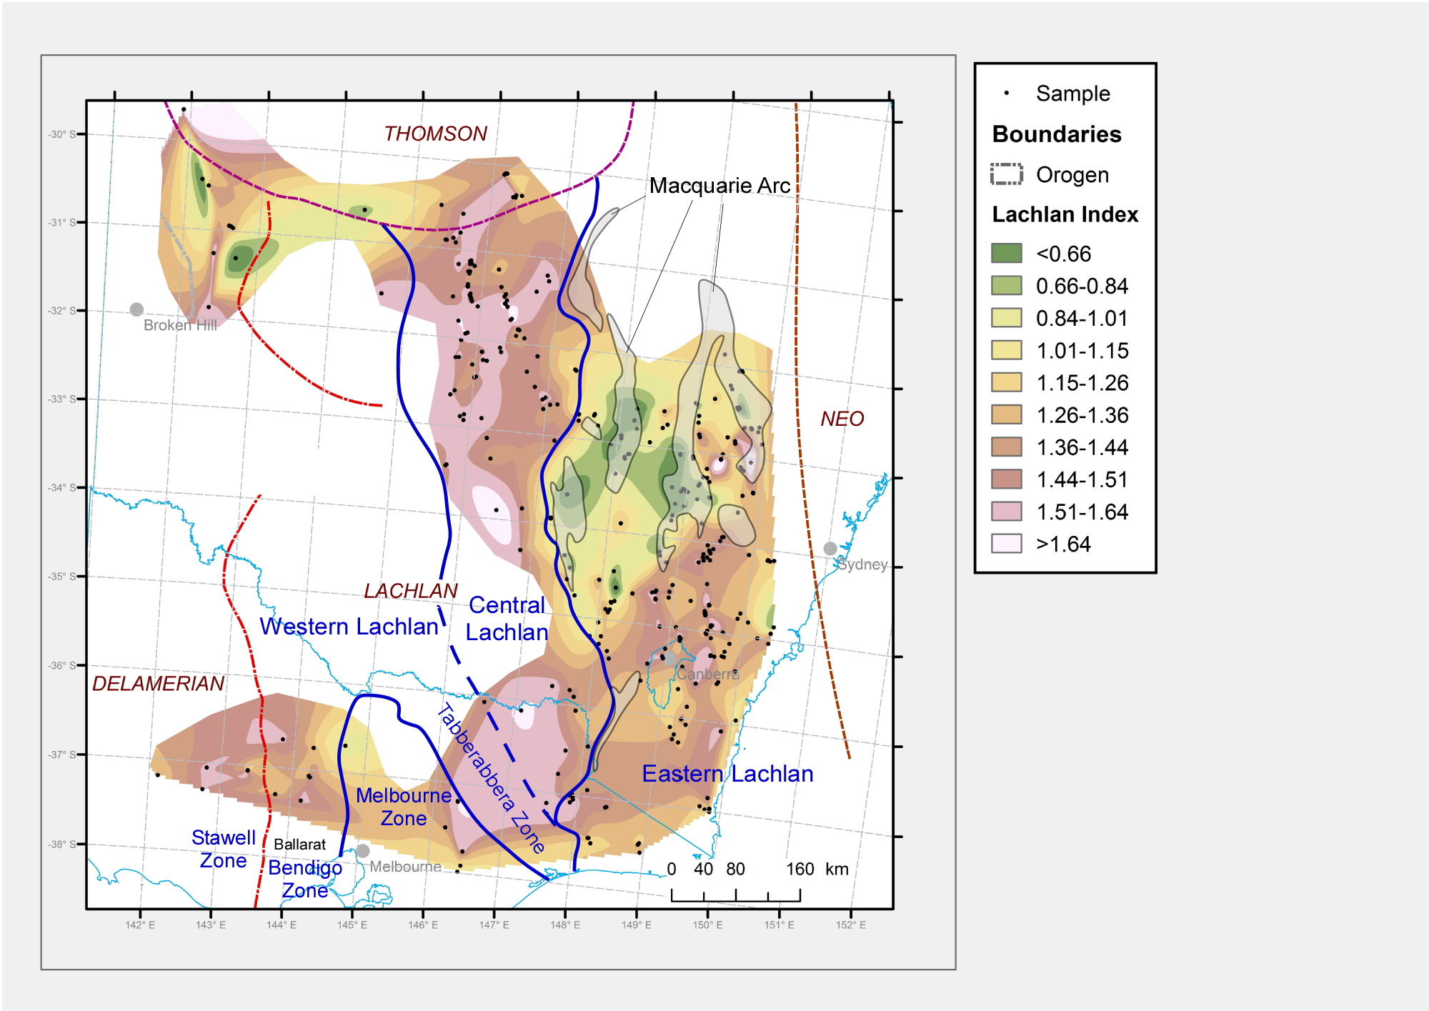
Lead isotopes in Lachlan – LLI and geologic provinces
Juvenile
Approximate
uncertainty
Evolved
Defines Central/Eastern Lachlan boundary
Macquarie “Arc” mostly juvenile (except far east)
Koonenberry belt complex
Central-western Victoria – insufficient data

Slide 16
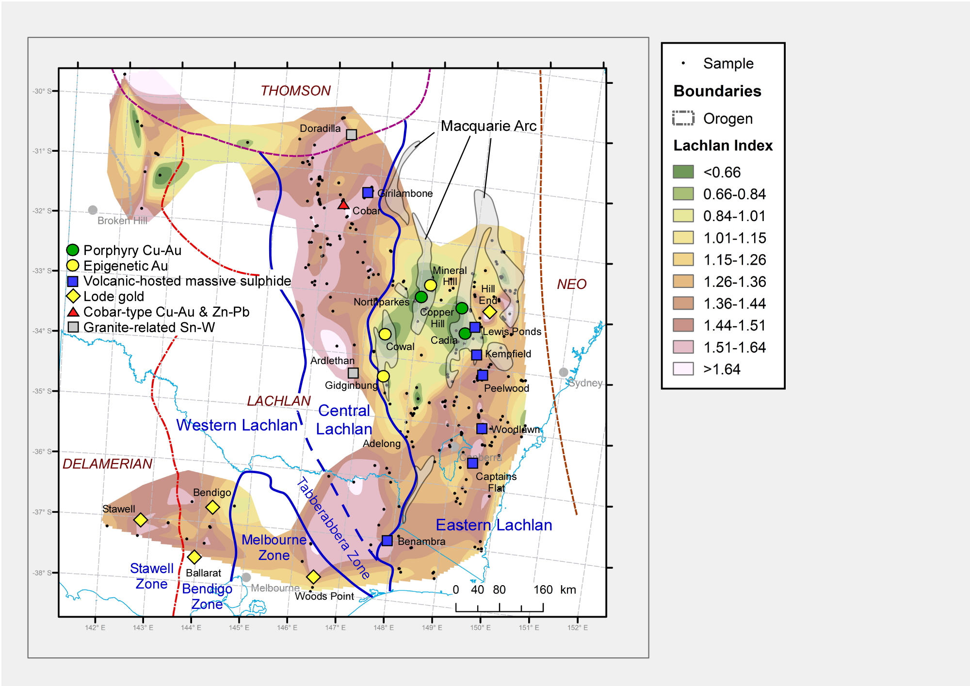
Lead isotopes in Lachlan – LLI and mineral deposits
Juvenile
Approximate
uncertainty
Evolved
Macquarie “Arc” porphyry-epithermal deposits associated with juvenile lead
Wagga Sn-Mo belt associated with evolved lead (age independent)

Slide 17
Lead isotopes in Lachlan – LLI and mineral potential
Juvenile
Approximate
uncertainty
Evolved
Extension of Cadia juvenile zone to southwest
Extension of Wagga Sn-Mo province into areas of no data

Slide 18
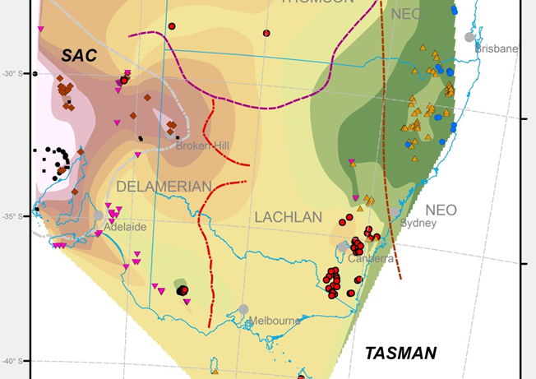

Lead isotopes in Lachlan – Comparison with Nd
Nd model ages
Champion (2013)

Slide 19
Lead isotopes in Lachlan – Cobar and Girilambone
Juvenile
Approximate
uncertainty
Evolved

Slide 20
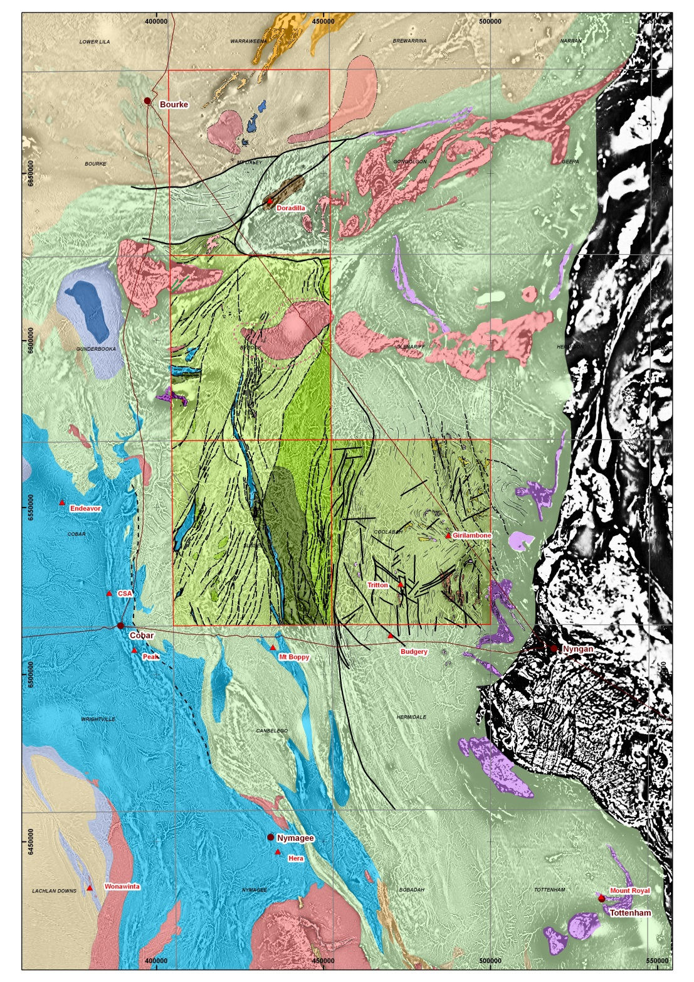
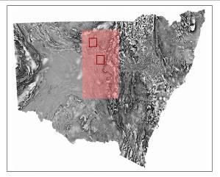

Geology of the Girilambone and Cobar districts
Quat |  | 1.8
Tert |  | 65
Cret |  | 144
Jur |  | 206
Tri |  | 248
Perm |  | 299
Carb |  | 359
Dev | L | 385
 | M | 398
 | E | 416
Sil | L | 423
 | E | 444
Ord | L | 461
 | M | 472
 | E | 488
Modern drainage
Gravel, silcrete, basalt
Lateritic
Ni, Co, Sc
Midway
granite
Channel Fe
Great Aust. Basin
Midway
granite
Sn skarn
Mulga Downs Gp
Structural base metals±Au
Cobar def.
Intrusion Sn, W, Mo
MVT, VMS
Cobar S-Gp
Benambran Or.
Orogenic Au
M-UM Ni±PGE
Ballast Fm
Lang Fm
Girilambone Gp
M-UM Ni±PGE
VMS Cu
Narrama Fm
Gilmore et al. (2012)

Slide 21
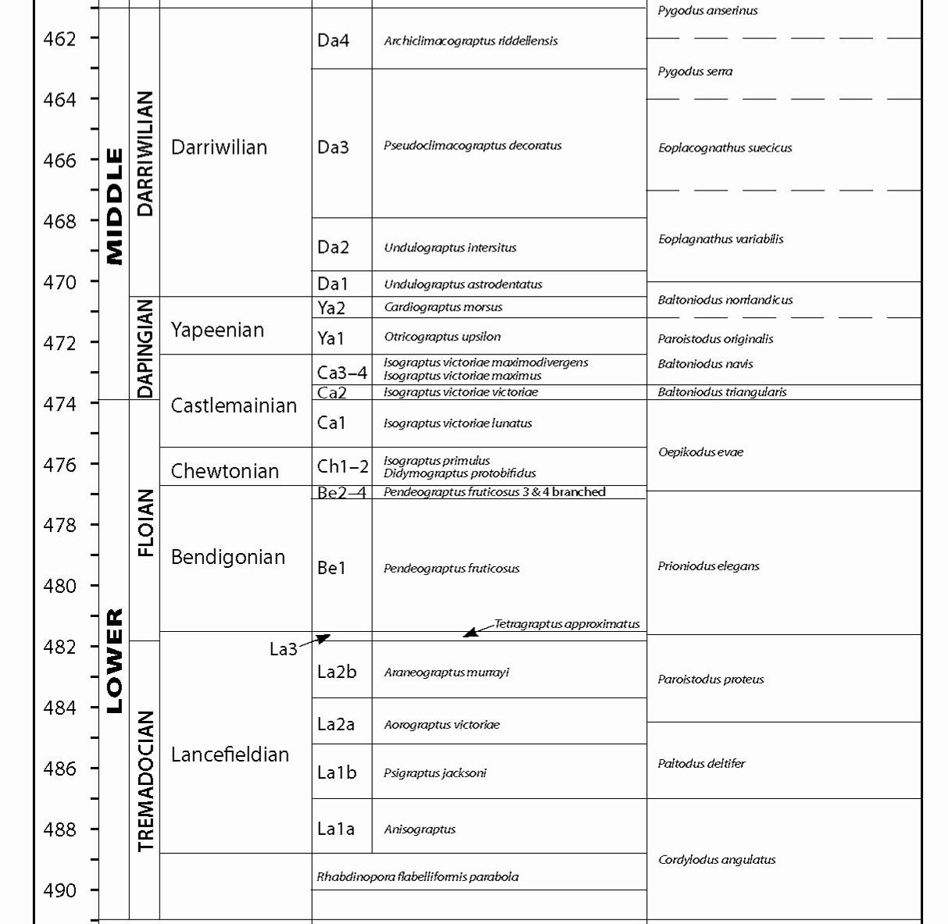
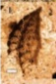
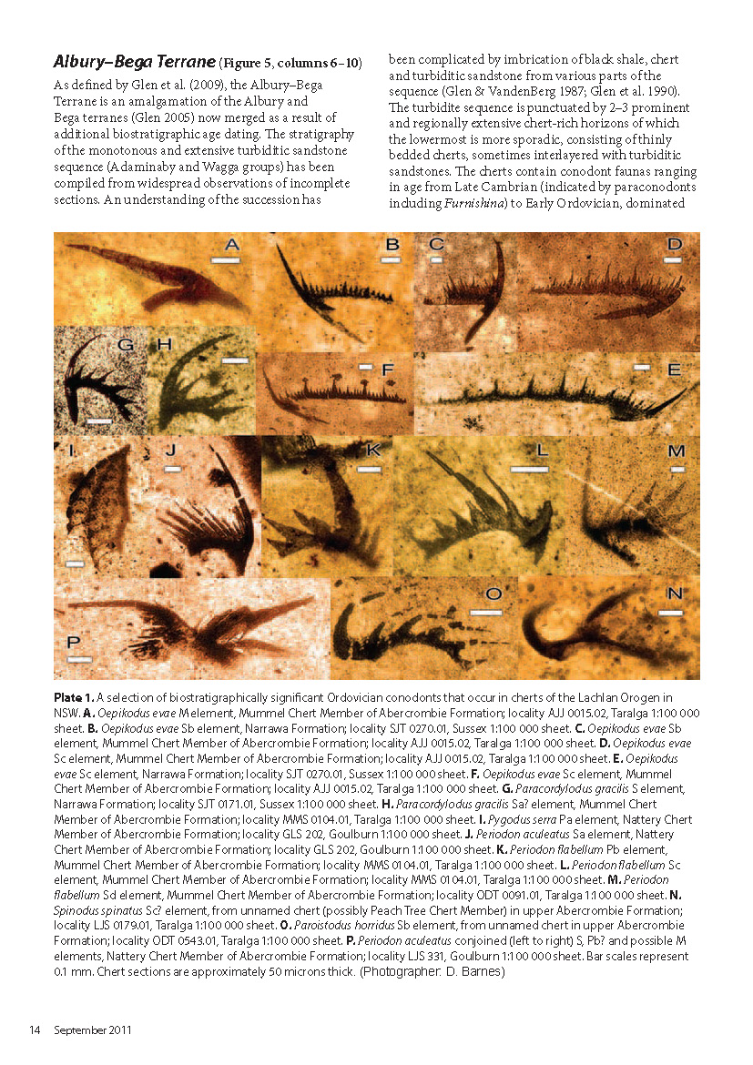
Girilambone Group – conodonts and age
??????????
??????????
Cherts
Cherts
Pygodus serra
Ballast Fm
Lang Fm
??????????
??????????
Girilambone Group
???????????????????????
Oepikodus evae
Cherts
Polpins Mbr
Narrama Fm
Paracordylodus gracilis
Exhalatives
Mt Dijou
MORB
???????????????????????
Ian Percival
in Gilmore et al. (2012)
Schematic only!
Youngest detrital zircons ~476 Ma (G Fraser in Gilmore et al., 2012)
Source: Percival et al. 2011

Slide 22
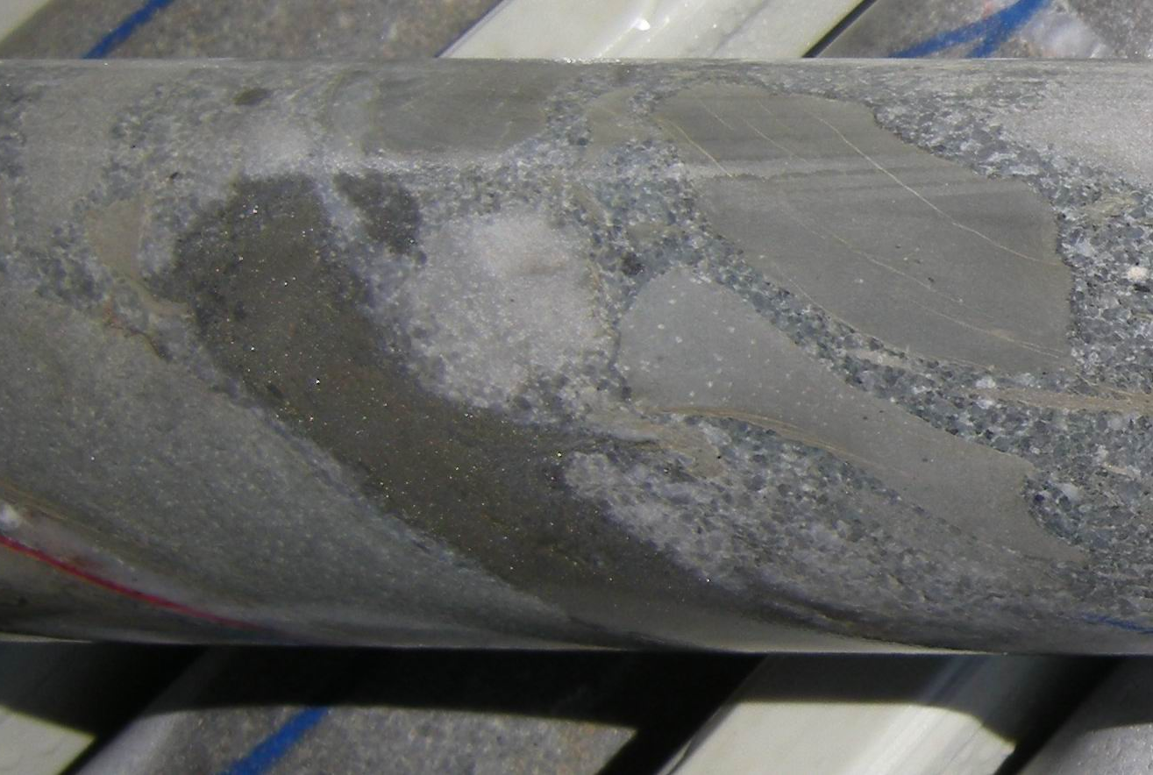
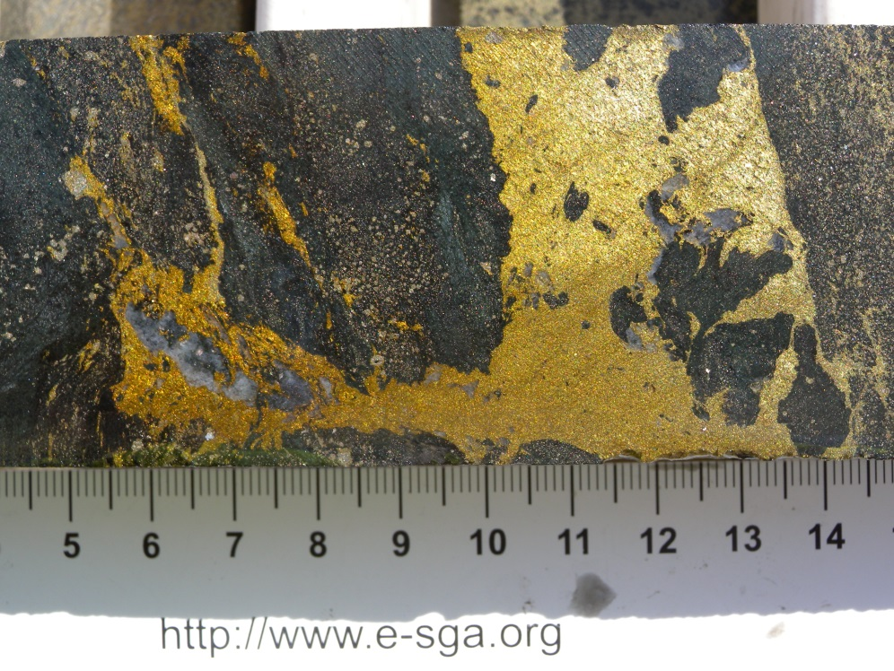
Girilambone and Cobar deposits – the controversy
Cobar deposits generally accepted as syn-tectonic deposits
Courtesy Phil Jones
⁴⁰Ar-³⁹Ar dating of sericite yielded ages of 405 Ma (Cu-rich deposits) to 384 Ma (Zn-rich deposits)
Tritton deposit (Girilambone district), originally interpreted as VHMS deposit
Courtesy Peter Downes
Tritton reinterpreted as syn-tectonic in late 1990s to early 2000s
Most recently, Straits Resources have re-reinterpreted deposit as VHMS

Slide 23

Cobar and Girilambone lead isotope data
Cobar lead
evolution
Girilambone model ages:
490-470 Ma
Modified Cumming and Richards (1975) pinned using Endeavor (384 Ma)

Slide 24
Girilambone and Cobar deposits – comments on origin
Most Girilambone lead is less radiogenic than Cobar lead
⇒ either Girilambone deposits significantly older or had different lead source (or both)
Most lead model ages for Tritton and Avoca Tank ~490-470 Ma; consistent with age of host succession ⇒ VHMS origin
One Tritton analysis indicates younger introduction of lead ⇒ possibly recrystallisation/remobilisation during Cobar event
Cobar data indicate model ages of 420-385 Ma; consistent with Ar-Ar age range from alteration sericite
Cobar data indicate that Cu-rich ores had a more juvenile source to the Zn-Pb-rich ores

Slide 25
Did Girilambone district form in a back-arc?
Girilambone Group presently inboard of Macquarie “Arc”
Girilambone Group contains MORB-like basalt (Burton, 2011)
Girilambone Group contains major detrital zircon population at ~476 Ma, similar in age to earliest (Phase 1, Glen et al., 2007) phase of Macquarie “Arc” magmatism
Most common tectonic setting for ancient VHMS deposits is back-arc or rifted arc

Slide 26
Temporal distribution of VHMS deposits in Tasmanides
Kanimblan
Delamerian
Hunter-Bowen
Tritton, etc
Bindian
Tabberabberan
Benambran
Lode gold
Kanimblan

Slide 27
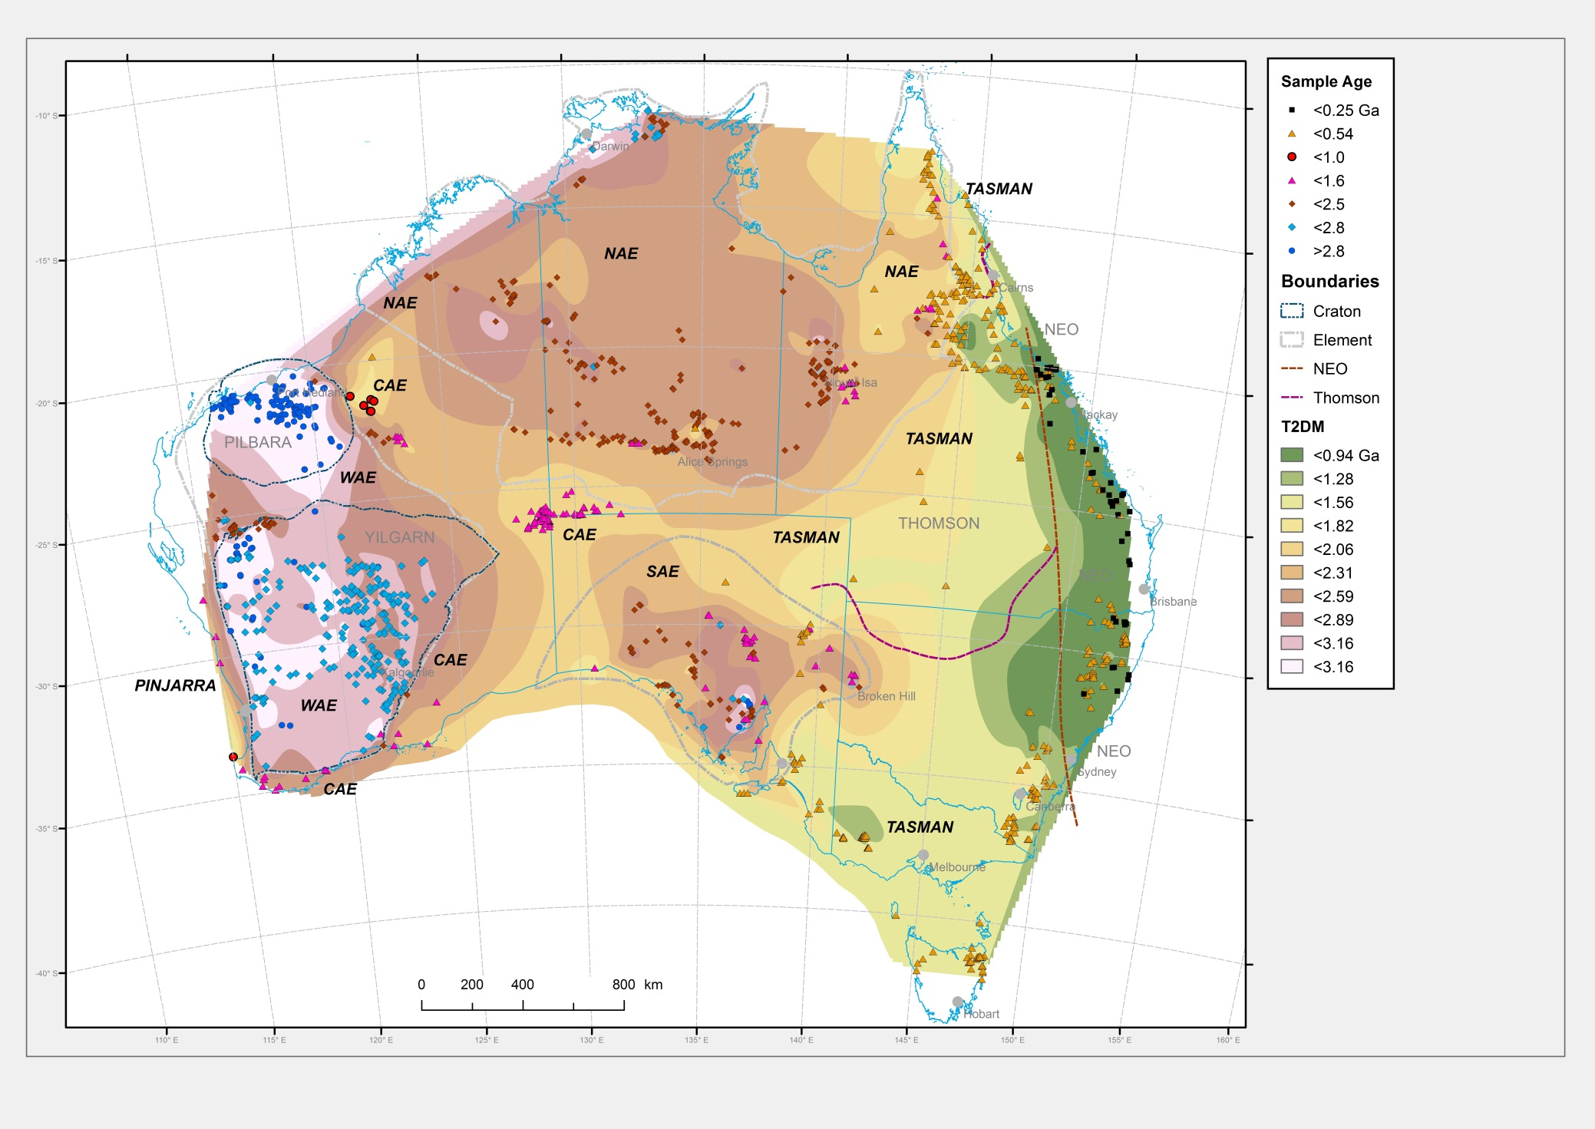
Advertisement – Nd map of Australia [Champion (2013)]

Slide 28
Advertisement – Current GA program in the Tasmanides
Southern Thomson drilling
(with GSQ and GSNSW)
Juvenile
Koonenberry MUM
geochronology
(with GSNSW)
Approximate
uncertainty
Evolved
Stavely drilling
(with GSV)

Slide 29
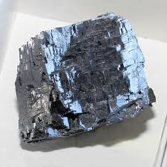
A request for samples:
Galena or Pb-rich (>1000 ppm) whole rock from Lachlan,
Delamerian, New England and Thomson orogens
www.kutztown.edu

Slide 30
